Slide 1
The Digital Codes

Slide 2
Binary Codes
A binary code is a rule used to assign a binary number for each discrete element.
With n-bit code we can represent up to 2n discrete elements.
Important Binary Codes
    BCD (Binary Coded Decimal)
    ASCII (American Standard code for information interchange)
    Gray code
    Excess 3 code
    Error Detection Codes

Slide 3
Binary Coded Decimal (BCD)
Would it be easy for you if you can replace a decimal number with an individual binary code?
  Such as 00011001 = 19₁₀
The 8421 code is a type of BCD to do that.
BCD code provides an excellent interface to binary systems:
  Keypad inputs
  Digital readouts

Slide 4
Binary Coded Decimal
Decimal Digit | 0 | 1 | 2 | 3 | 4 | 5 | 6 | 7 | 8 | 9
BCD | 0000 | 0001 | 0010 | 0011 | 0100 | 0101 | 0110 | 0111 | 1000 | 1001
Note: 1010, 1011, 1100, 1101, 1110, and 1111 are INVALID CODE!
Let’s crack these…
ex1: dec-to-BCD
35
98
170
2469
ex2: BCD-to-dec
10000110
001101010001
1001010001110000

Slide 5
BCD Addition
BCD is a numerical code and can be used in arithmetic operations. Here is how to add two BCD numbers:
  Add the two BCD numbers, using the rules for basic binary addition.
  If a 4-bit sum is equal to or less than 9, it is a valid BCD number.
  If a 4-bit sum > 9, or if a carry out of the 4-bit group is generated it is an invalid result. Add 6 (0110) to a 4-bit sum in order to skip the six the invalid states and return the code to 8421. If a carry results when 6 is added, simply add the carry to the next 4-bit group.

Slide 6
BCD Addition
Try these:
ex: Add the following numbers
(a) 0011+0100
(b) 00100011 + 00010101
(c) 10000110 + 00010011
(d) 010001010000 + 010000010111
(e) 1001 + 0100
(f) 1001 + 1001
(g) 00010110 + 00010101
(h) 01100111 + 01010011

Slide 7
The Gray Code
The Gray code is unweighted and is not an arithmetic code.
  There are no specific weights assigned to the bit positions.
Important: the Gray code exhibits only a single bit change from one code word to the next in sequence.
  This property is important in many applications, such as shaft position encoders.

Slide 8
The Gray Code
Decimal | Binary | Gray Code
0 | 0000 | 0000
1 | 0001 | 0001
2 | 0010 | 0011
3 | 0011 | 0010
4 | 0100 | 0110
5 | 0101 | 0111
6 | 0110 | 0101
7 | 0111 | 0100
Decimal | Binary | Gray Code
8 | 1000 | 1100
9 | 1001 | 1101
10 | 1010 | 1111
11 | 1011 | 1110
12 | 1100 | 1010
13 | 1101 | 1011
14 | 1110 | 1001
15 | 1111 | 1000

Slide 9
The Gray Code
Binary-to-Gray code conversion
  The MSB in the Gray code is the same as corresponding MSB in the binary number.
  Going from left to right, add each adjacent pair of binary code bits to get the next Gray code bit. Discard carries.
  ex: convert 10110₂ to Gray code
  1 + 0 + 1 + 1 + 0 binary
  1 1 1 0 1 Gray

Slide 10
The Gray Code
Gray-to-Binary Conversion
  The MSB in the binary code is the same as the corresponding bit in the Gray code.
  Add each binary code bit generated to the Gray code bit in the next adjacent position. Discard carries.
  ex: convert the Gray code word 11011 to binary
  1 1 0 1 1 Gray
  + + + +
  1 0 0 1 0 Binary

Slide 11
The Gray Code
2-bit Gray code
1-bit Gray code
00
01
00011110
01
11
10

Slide 12
The Gray Code
3-bit Gray code
0000
00011110
000001011010110111101100
2-bit Gray code
00011110
1111
10110100

Slide 13
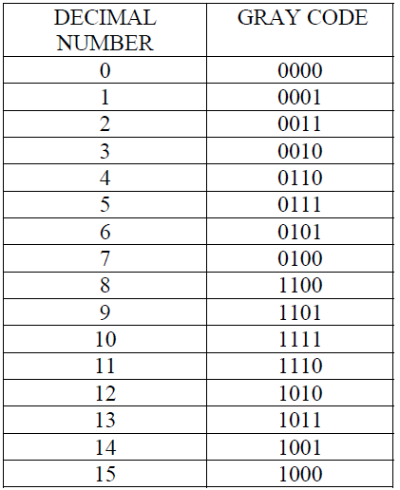
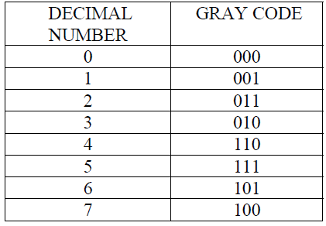
Gray Code

Slide 14
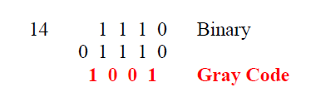

Conversion(Binary to Gray )
Place a leading zero before the MSB.
Compare the adjacent bit starting from the leading Zero.
If the two compared bits are same then 0, if not then 1.

Slide 15
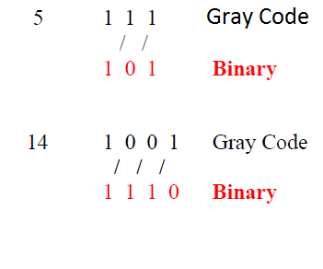
Conversion(Gray to Binary )
Drop the MSB.
Compare this to the next adjacent bit.
If the compared bits are same then 0, if not then 1.

Slide 16
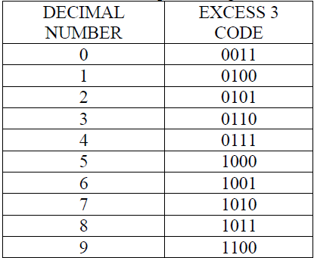
Unweighted Binary Code
Excess 3 code
It is Obtained by adding
3(0011 in Binary) to the
8421 code
Reflected and Self
Complementing.

Slide 17
Error Detection Codes
Used to detect error in digital circuits especially during transmission of bits from one location to another.
System use a parity bit as a mean for bit error detection .
Contains either an even or an odd number of 1’s.
A parity bit is an extra bit attached to a group of bits to make the total number of 1’s in a group either even or odd.

Slide 18
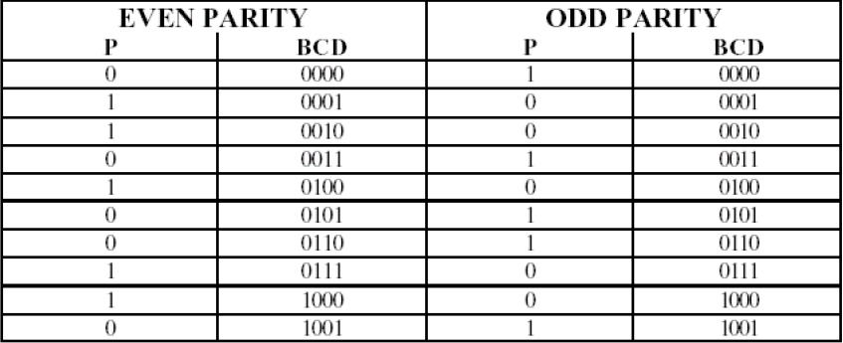
Continued….

Slide 19
Alphanumeric Codes
Represent numbers and alphabetic characters.
  Also represent other characters such as symbols and various instructions necessary for conveying information.
The ASCII is the most common alphanumeric code.
  ASCII = American Standard Code for Information Interchange

Slide 20
ASCII
ASCII has 128 characters and symbols represented by a 7-bit binary code.
  It can be considered an 8-bit code with the MSB always 0. (00h-7Fh)
    00h-1Fh (the first 32) – control characters
    20h-7Fh – graphics symbols (can be printed or displayed)

Slide 21
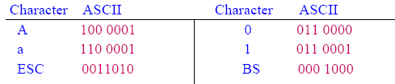
ASCII Code
American Standard Code for Information Interchange.
Used in communicating information between a computer and its peripherals or other computers.
Each letter, digit or character is represented by 7-bit code
ASCII code (128 discrete elements: 94 printable characters and 34 control characters)

